Slide 1
Airline Data Analysis
Insights and Trends Using Python and MySQL
Presented by: Sandeep Patidar
Exploring Airline Data for Business Insights

Slide 2
Problem Statement
Title: Analyzing Passenger and Flight Data for Strategic Insights in the Airline Industry
Challenge: Airlines face challenges in managing flight operations, understanding passenger demographics, and optimizing airport logistics. Analyzing this data can help in improving operational efficiency, enhancing customer satisfaction, and making data-driven decisions.
Problem Statement:
Identifying trends in passenger demographics, flight performance, and airport preferences. Detecting outliers and cleaning data for better accuracy. Understanding seasonal variations and their impact on flight punctuality and passenger flow.

Slide 3
Goal & Summary
Title: Objectives & Key Insights
Goal: Analyze airline data effectively using Python libraries (NumPy, Pandas, Matplotlib) and MySQL. Present meaningful insights through data analysis and visualizations.
Summary of Findings: Passenger demographics show distinct patterns based on age, gender, and nationality.
Analysis of flight performance reveals key factors affecting delays and on-time arrivals.
Data cleaning (handling null values & outliers) enhanced the accuracy of insights.
Seasonal trends in passenger flow and airport preferences were identified.

Slide 4
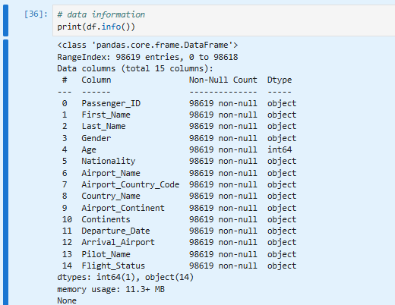
Columns and Type

Slide 5
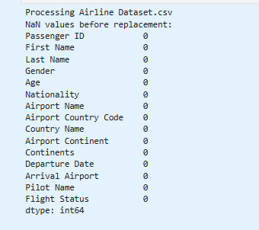
Null Values

Slide 6
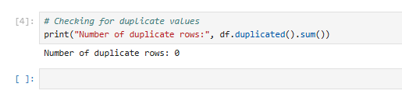
Duplicate Values
Discusses the presence of duplicate records in the dataset, which can lead to biased results. It describes how duplicate values were identified and removed to maintain data integrity, ensuring more accurate analysis.
The rows of duplicate value is zero.

Slide 7
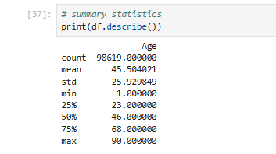
Summary Statistics
Presents the initial statistical summary of the dataset before handling outliers. This includes measures such as mean, median, and standard deviation, highlighting potential anomalies that could impact the results.

Slide 8
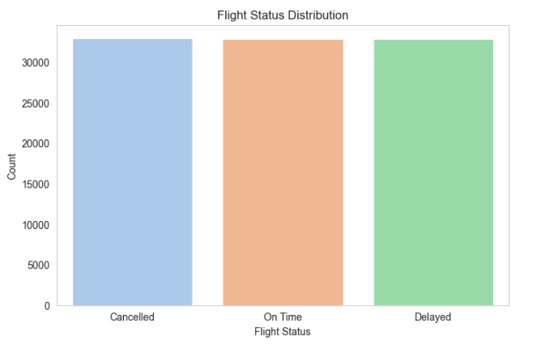
Flight Status Distribution
The flight status distribution shows a nearly equal count of Cancelled, On Time, and Delayed flights. This balance suggests that no single status overwhelmingly dominates the dataset. The distribution can help in analyzing factors influencing flight delays or cancellations. Further exploration can identify patterns to improve operational efficiency and reduce delays.

Slide 9
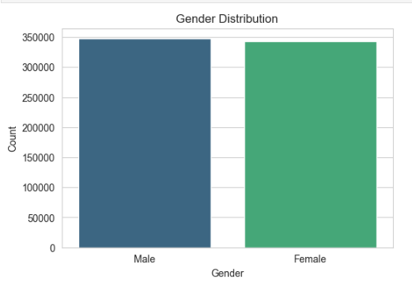
Gender Distribution by Count
The gender distribution of passengers is relatively balanced, with a slightly higher count of Male passengers compared to Female. This near-equal distribution suggests diverse representation in the dataset. Such balanced data can help in unbiased demographic analysis. Further exploration can reveal if there are any significant behavioral differences between the genders in flight preferences or delays.

Slide 10
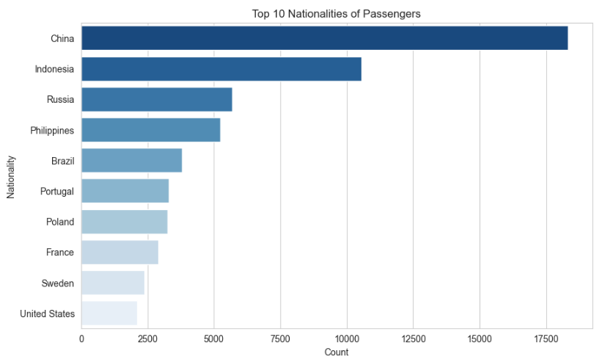
Top 10 Nationalities
The majority of passengers belong to China and Indonesia, indicating a strong presence from these nationalities.

Slide 11
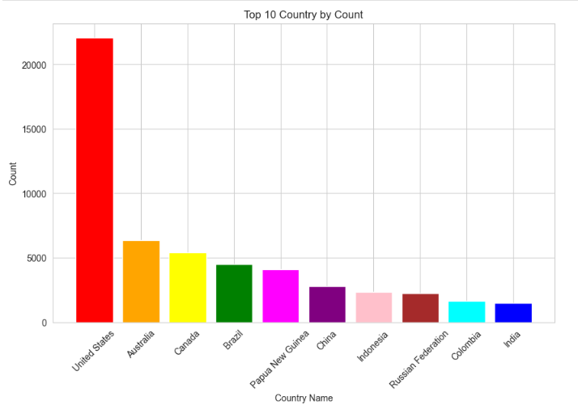
Top 10 Country by Count

Slide 12
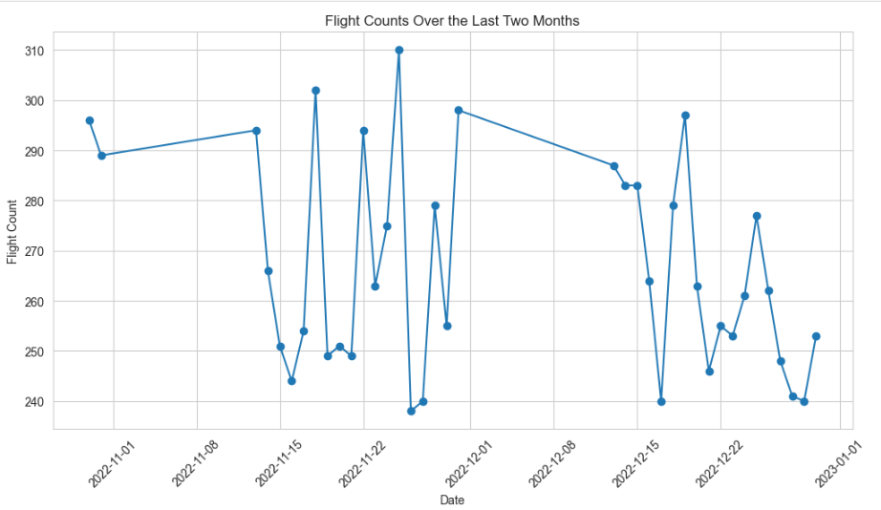
Flights of Two Months
The plot shows fluctuations in daily flight counts over the last two months. There are noticeable peaks and drops, indicating potential irregularities or external factors affecting flight frequency.

Slide 13
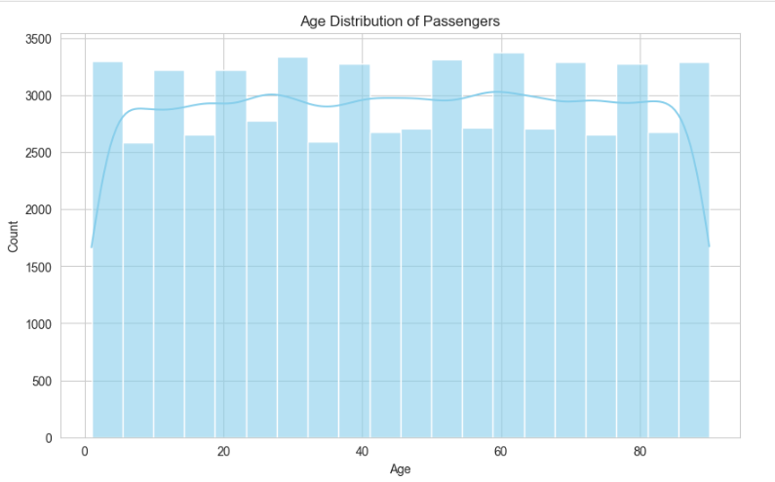
Age of Passengers
The plot displays the age distribution of passengers, ranging from infancy to the elderly. Most age groups are evenly represented, indicating a balanced demographic of travelers.

Slide 14
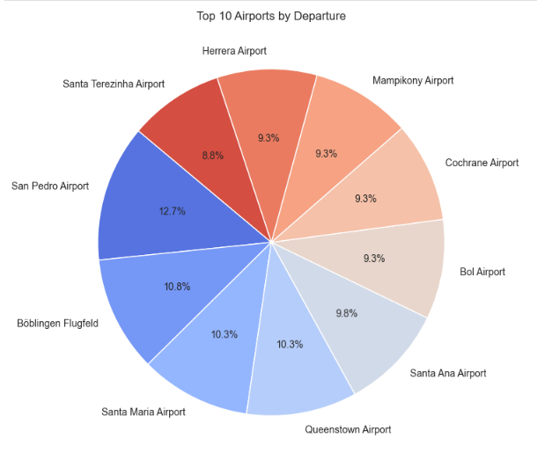
Top 10 Airports

Slide 15
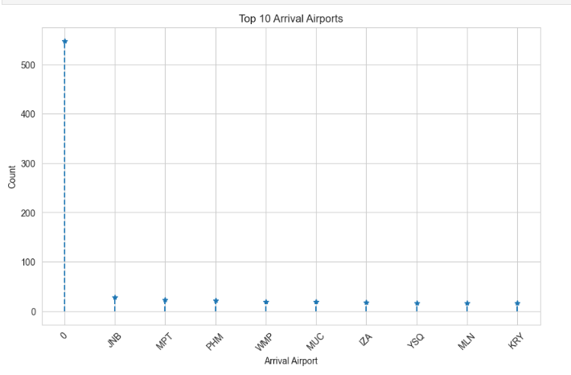
Top 10 Arrival Airports

Slide 16
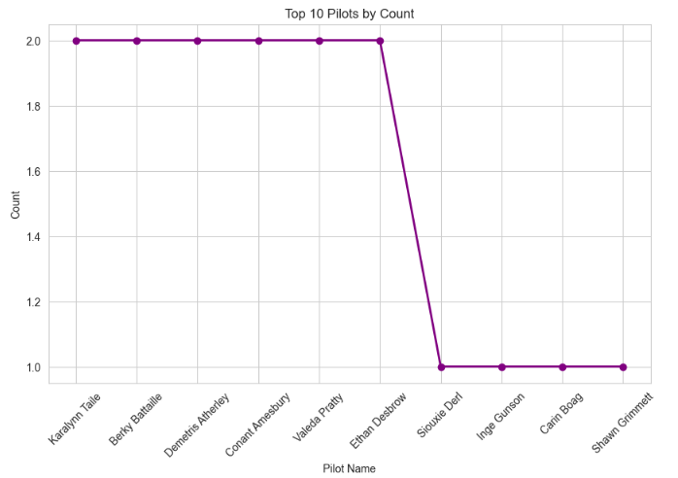
Top 10 Pilots
This suggests a relatively equal distribution of flight responsibilities among the leading pilots, though the drop to one flight for some indicates possible variations in scheduling or data limitations.

Slide 17
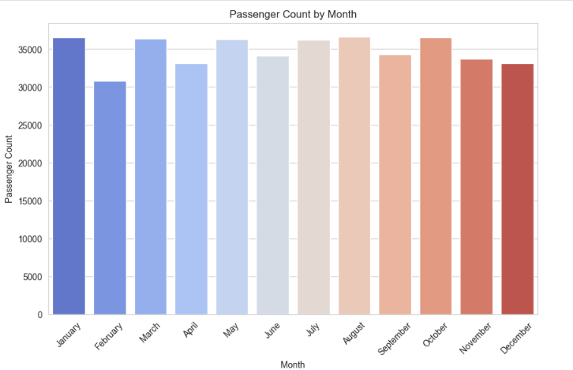
Passenger Count by Month
January has the highest passenger count, possibly due to New Year travel.
A slight decline in February, likely influenced by the shorter month.
A relatively stable distribution from March to October, suggesting consistent travel activity.

Slide 18


